Slide 1



Datageletterdheid
Workshop 4

Slide 2
Inhoud
Mentimeter Exploring data with python
Machine learning

Slide 3
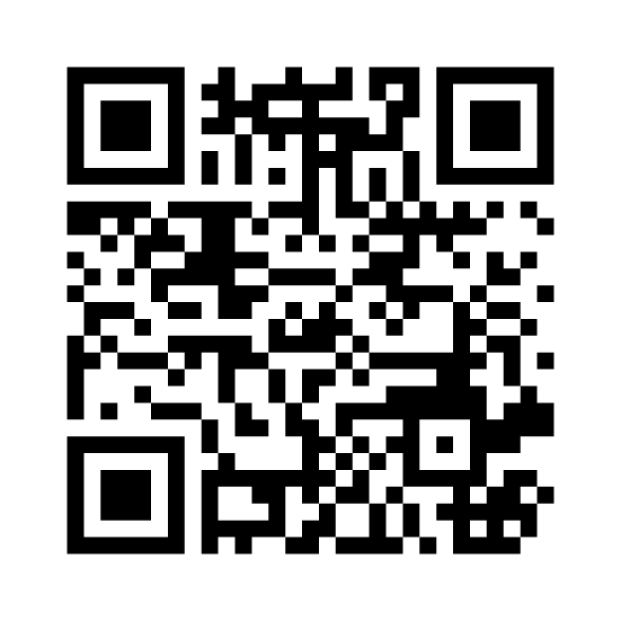
Mentimeter Exploring data with python

Slide 4
Machine learning
Wat is machine learning?

Slide 5
Machine learning
“Machine learning is a branch of artificial intelligence (AI) and computer science which focuses on the use of data and algorithms to imitate the way that humans learn, gradually improving its accuracy.”
- IBM

Slide 6
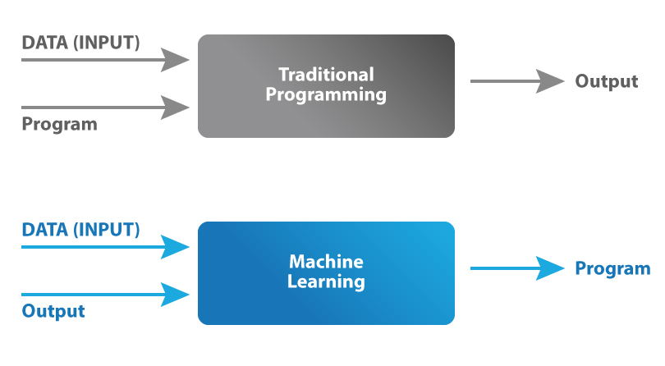
Machine learning

Slide 7
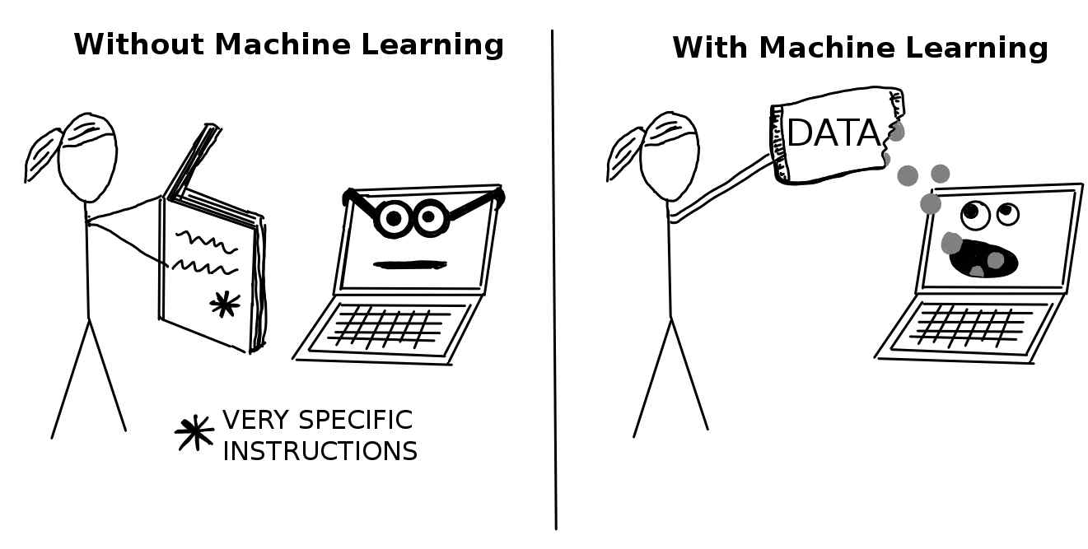
Machine learning

Slide 8
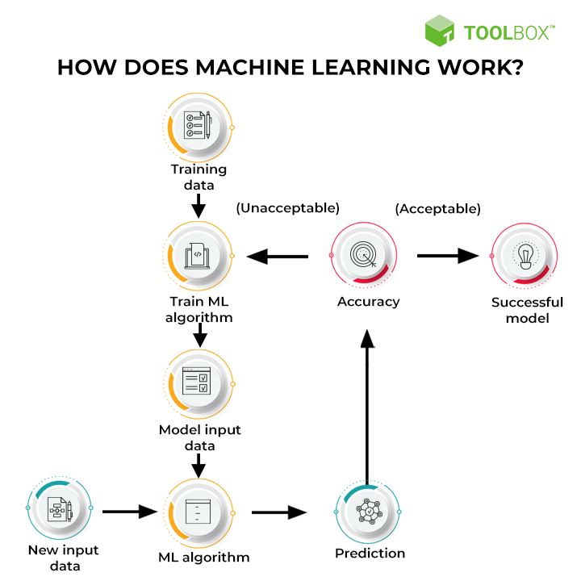
Machine learning

Slide 9
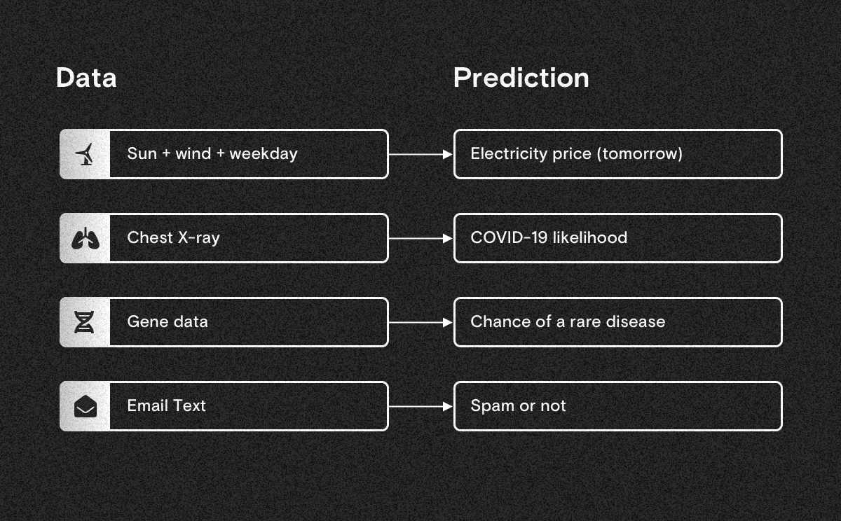
Machine learning

Slide 10
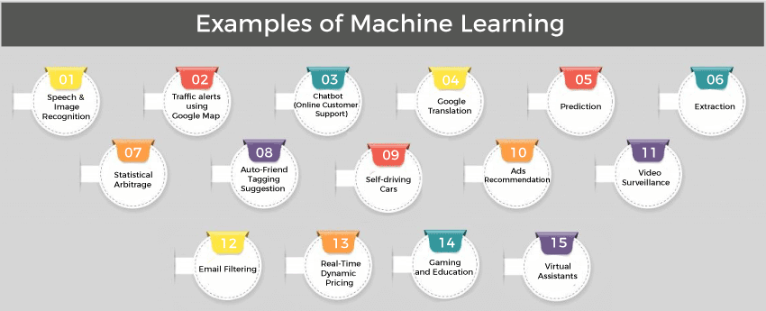
Machine learning

Slide 11
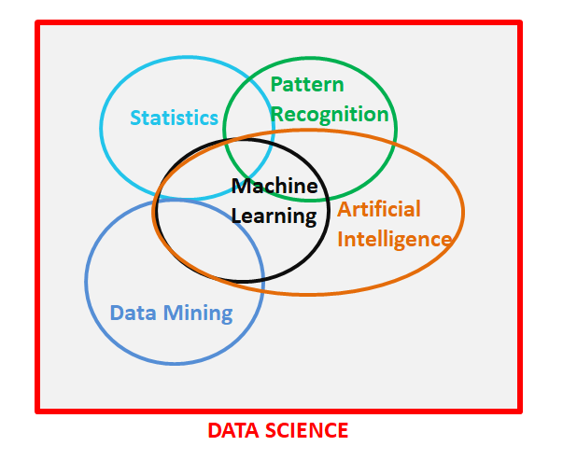
Machine learning

Slide 12


De opdracht
Maak op Codecademy van de course “Getting started with Python for Data Science” de tweede en derde module genaamd Sorting and filtering rows en Cleaning and transforming columns

Slide 13
Aan het werk!
Als je vragen hebt, kom bij me langs!

